Slide 1
Introduction
By
Priyanka More

Slide 2
Dax expressions
Time Intelligence functions in DAX allow to manipulate data using
Time periods such as days, months, quarters, and Year.
YOY function - Year To Year. Its show in % - (YOY%)
YOY means calculate “Year To Year “ , and in Power Bi, it is used to compare a measure’s performance in current year against the same measure in the previous year.

Slide 3
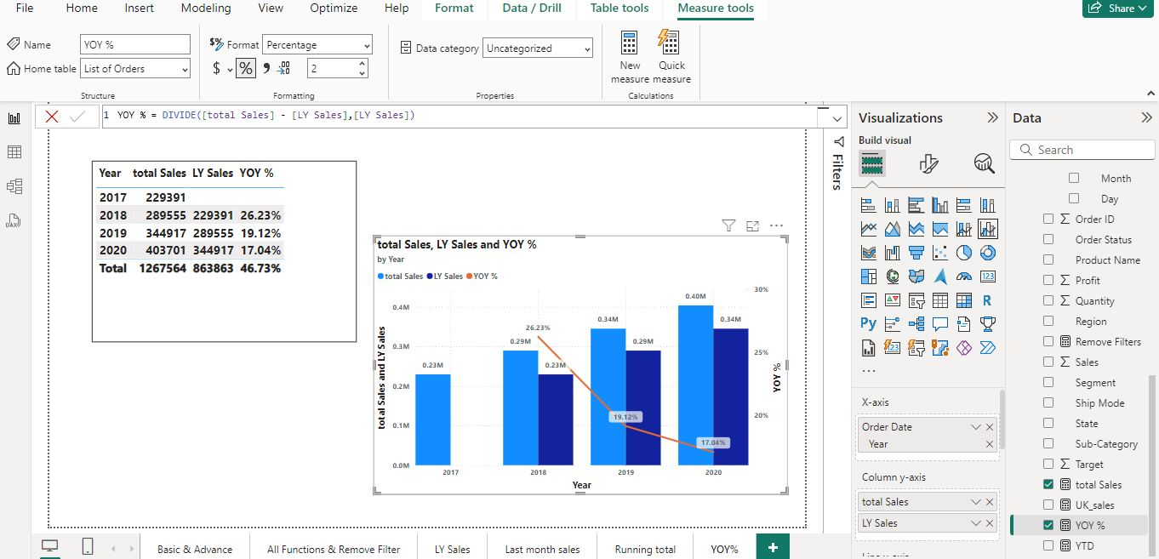

Slide 4
Thank You

